Slide 1
Protection and promotion of the rights of Refugees and Internally Displaced persons.
Definitions and Context

Slide 2
Starting from Definitions
Human Rights
Human rights foundation principles
Human rights standards
Human rights obligations
Human rights violations
Human rights protection
IHL
Notes:
As you all know, NHRIs mandate include the responsibility to protect the effective enjoyment by all of all human rights, and to coordinate
human rights protection activities at the national level. NHRIs engagement in monitoring, fact-finding and investigations at
is one of the most significant ways in which to fulfil this mandate.
In the next slides, we are briefly going to review the main definitions listed up here.

Slide 3
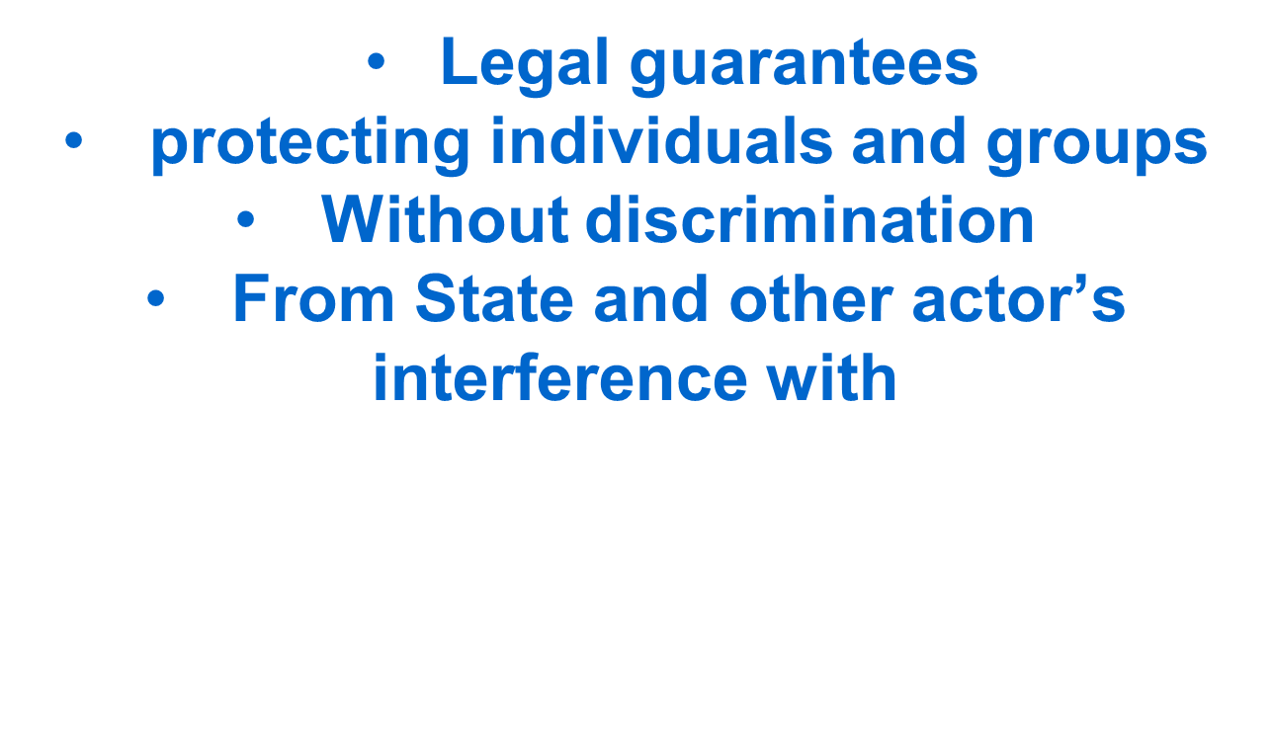
Human Rights are …

Slide 4
Foundation Principles of Human Rights
1. Equality
The basis of human rights is that “ all human beings are born free and equal in dignity and rights” (UDHR Art. 1).
2. Universality
Human Rights are certain moral and ethical values shared in all the regions of the world, and government and communities should recognize and uphold them.

Slide 5
Foundation Principles of Human Rights
3. Non-discrimination
Human rights law affords the same rights and responsibility equally to all women and men, boys and girls on account of them being human beings, regardless of any role or relationship they may have.
4. Indivisibility
All human rights should be addressed as a unit including civil, political social economic cultural and collective rights.

Slide 6
Foundation Principles of Human Rights
5. Interdependence
Human rights concerns appear in all spheres of lives – home, school, workplace, court, market – everywhere.
Human rights violations are interconnected; loss of one right adversely affects the other. Similarly, promotion of one right supports the other.
6. Responsibility/Accountability
a) Government responsibility:- Human rights are not gifts given at the pleasure of governments:- Government should not withhold them or give them to some people but not to others. When they do so they should be held accountable,

Slide 7
Foundation Principles of Human Rights
b) Individual responsibility:-
Every individual has the duty to know and teach human rights,
Every individual must respect human rights
Every individual has a duty to challenge institutions and individuals that abuse human rights.
c) Other responsibilities
- Every organ of society including corporations, NGOs educational institution share the duty for the provision and protection of human rights.

Slide 8
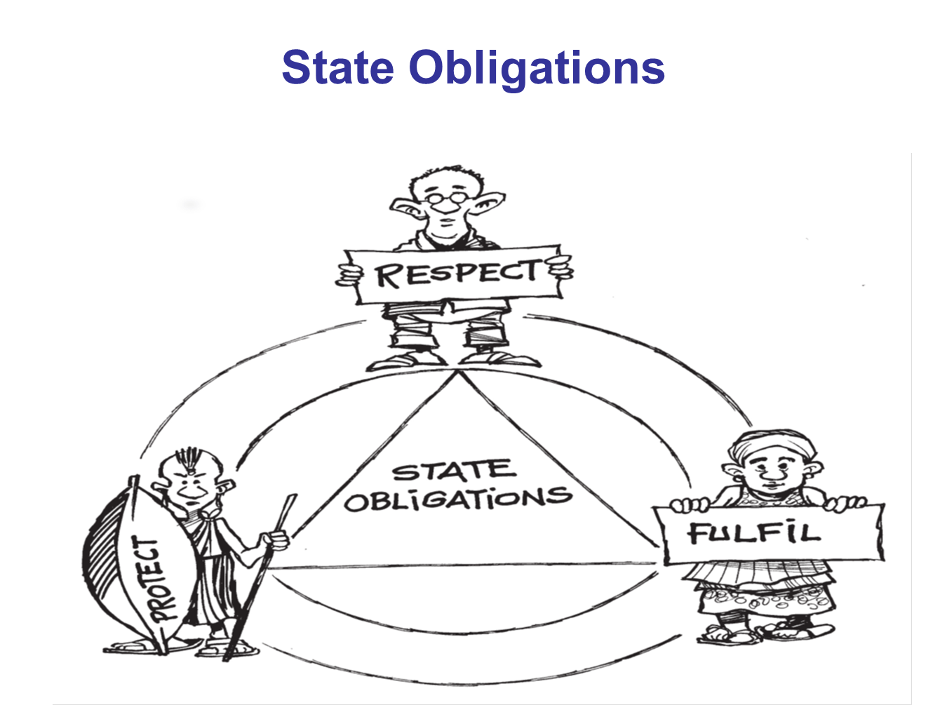
State Obligations

Slide 9
Three types of obligations of States
All categories of human rights imposes responsibilities on States to take steps to:
a
RESPECT
FULFILL
PROTECT
Refrain from interfering with the enjoyment of rights
Prevent others from interfering with the enjoyment of rights
Adopt appropriate measures towards full realization of rights

Slide 10
Human Rights Obligations of States
Through ratification of International human rights treaties govts agree to take domestic measures and introduce legislation to implement their obligations and duties
They assume duties to respect, to protect, and to fulfill human rights obligations.
Respect: States must refrain from interfering with or curtailing enjoyment of human rights
Protect: Protect individuals and groups against h/rts abuses
Fulfill: Take positive steps/action to facilitate the enjoyment of h/rts.

Slide 11
Human Rights Violations…
When we refer to “violations”, we are referring to the State failure to comply with its obligations through:
OMISSIONS
ACTS

Slide 12
Human Rights Violations
International human rights law imposes obligations on state parties not on private individuals.
The state has the duty to ensure protection and promotion of human rights. In international law violations of human rights are therefore committed by the state through its servants, or agents, or persons acting with state instruction or approval or support or with the acquiescence of state officials.
There is a distinction between human rights violations and human rights abuse. Acts and omissions of non-state actors that breach human rights constitute human rights abuse while acts or omissions of state actors that infringe on the enjoyment of human rights are violations.
International human rights law takes the position that human rights abuses should be dealt with through the criminal or civil law process

Slide 13
Human Rights Violations Defined
“Human rights violation” can be defined as a negation, contravention of or failure to prevent the breach of human rights standards by the State acting through public officials or state agents whether by an act, negligence or omission or acquiescence with an act or omission contravening or negating human rights.
What this means is that human rights violations are not committed through overt acts of public officers only but can also be due to failure of public officials to act to prevent violation.
Failure to prevent violations is a wide concept: it includes failure by the state through its servants, agents to effectively take steps to protect or promote human rights. E.g. failure to investigate violations or abuses and therefore accord victims appropriate remedies and protection or to punish perpetrators is failure to protect by the State.
Such omissions for which the state is accountable can be due to deliberate failure to act or due to negligence on its part.

Slide 14
Human Rights Violations Defined
In accordance with international law and the definition of human rights violation above, violations are:
Acts committed by public officials, or
Acts committed at the instigation of a public official or his/her agent
Due to the negligence of public officials, or
Failures by officials to perform their duties or responsibilities under the law, or
Failures by public officials to prevent a violation from taking place, or
Acts committed by an agent of the state, or
Acts committed with the acquiescence of a public official or his/her agent.

Slide 15
Examples of Human Rights Violations
Human rights violation can be a singular violation of an individual right or large scale violations of one or more than one right. Examples of violations:
Deliberate targeting of civilians and civilian property in situation of armed conflict
Forced and large scale population displacement
Arbitrary arrest and detention
Excessive use of force by the police
Failure by the State to investigate alleged violations
Forcible eviction from homes.
Failure to ensure a decent living standard for refugees or IDPs
Often the violation of one ESCR links to the violation of other rights.

Slide 16
Human Rights Protection…
Protection is defined as all activities aimed at obtaining full respect for the rights of the individual in accordance with the letter and spirit of the relevant bodies of law, namely human rights law, international humanitarian law, regional human rights law customary human rights law.
Protection is a legal obligation and it is an activity of necessary steps and measures
Responsive-to prevent or stop violations
Remedial-remedies for violations including through access to justice and reparations.
Environment building- to promote respect for rights and rule of law.
Human rights protection results when, through specific actions, individuals who otherwise would be at risk or subject to deprivation of their rights, are able to fully exercise them.
Human rights can also be protected when the State takes measures designed for the promotion, protection and fulfillment of human rights.

Slide 17
Human Rights Protection…
Relevance of regional and international Instruments cont.
Protection is about ensuring that all persons including refugees and IDPs (women, men, children, girls and boys can enjoy their rights equality, in safety and dignity.
National laws constitute the primary legal framework for protection activities and should conform with a State’s international and regional legal obligations.
An understanding of the rights of refugees and (IDPs) and the legal obligations of States and other authorities under international and regional law is, therefore, essential.
Protection efforts, must be anchored in national, regional and international law and be based on respect, protection and promotion of human rights.

Slide 18
Human Rights Protection…
Relevance of regional and international Instruments cont.
International and regional law define the rights of individuals and groups and the obligations of States for the protection of these rights, and it is essential in protection activities at the national and international levels. International and regional law provides clear standards and objective criteria for protection of rights that can help to:
assess to what extent human rights are being respected and identify the risks or obstacles that refugees or IDPs face in exercising their rights;
clarify the responsibility of the national authorities and the actions that must be taken to fulfil that responsibility;
develop effective operational response to humanitarian crisis, using rights-based approaches;
provide a basis for advocacy, awareness raising, training, capacity building; and
guide activities, conduct, and interactions with populations of concern.

Slide 19
Human Rights Protection Instruments
International and regional law.
International and regional laws are the body of law governing the conduct of, and relations between, States
International or regional law: derived from: international treaties and customary law. A treaty can also be known as a covenant, convention, charter or protocol.
Customary international or regional law or custom: general and consistent practice of States followed out of a sense of legal obligation. It is binding on all States, unless a State has persistently objected to the practice.
International law also contains peremptory norms (jus cogens) accepted and recognized by States as norms from which no derogation is permitted. These include, for instance, the prohibition against genocide, slavery and racial discrimination.
Resolutions of the United Nations Security Council: adopted under Chapter VII of the United Nations Charter are binding.
Resolutions and declarations of States e.g. by the UN General Assembly and the UN Human Rights Council: non-binding, but important normative statements and may provide an indication of emerging international custom.
Secondary sources of international law, i.e. doctrine and jurisprudence: jurisprudence of courts and tribunals relating to the protection of h/rts, such as regional courts or commissions on human rights, special tribunals or ICC.

Slide 20
Human Rights Protection Instruments
Key human rights instruments.
UDHR of 1948, establishes the main civil, political, economic, social and cultural rights to which all persons are entitled, without discrimination of any kind.
UDHR non-binding but its principles constitute customary law and/or have been incorporated into treaties.
UDHR principles are now in legally binding instruments: International Covenant on Economic, Social and Cultural Rights (ICESCR) and International Covenant on Civil and Political Rights (ICCPR)-International Bill of Rights.
Several additional instruments reinforce the protection of human rights relating to:
particular issues, such as torture or racial discrimination; or
specific groups of persons, including women, children, persons with disabilities and indigenous persons, who have faced particular obstacles to the full and equal enjoyment of their rights.
Although none of these instruments specifically addresses refugees and IDPs, they do cover a range of risks that refugees and IDPs often face and reinforce protection for particular groups of persons who tend to be disproportionately affected by displacement or refugee situation.
Protection of human rights is also reinforced in a number of regional human rights instruments

Slide 21
Human Rights Protection Instruments
International humanitarian law.
IHL are laws consisting of treaties and customs applicable in armed conflict and are specifically intended to address humanitarian problems that arise directly from armed conflicts.
IHL therefore sets minimum standards of behaviour during armed conflict and military occupation and regulate means and methods of war by restricting methods to be applied.
Purpose: To protect persons who are not or are no longer directly participating in hostilities. Protecting civilians during armed conflict is the cornerstone-their lives, property, women, children, IDPs, refugees.
IHL is part of public international law- a broad set of treaties, customary law, principles and norms.
The core instruments of international humanitarian law: the four Geneva Conventions of 1949 and their two Additional Protocols of 1977.
Many of the key principles contained in these instruments also constitute customary international law, which means that they are automatically binding in all situations of armed conflict and on all parties to a conflict.

Slide 22
IHL Principles
IHL is founded upon the following principles:
distinction between civilians and combatants during armed conflict.
prohibition of attacks against those not involved in armed conflict
prohibition on the infliction of unnecessary suffering
principle of proportionality
notion of necessity
principle of humanity

Slide 23
IHL Principles
The principle of distinction between civilians and combatants
The principle of distinction is that only fighters may be directly targeted.
This is a necessary to protect civilians during armed conflict for without the principle there would be no limitation on the methods of warfare.
The principle is in Article 48 and 52 of AP I to the GCs which define who is a combatant and a military object that can be lawfully attacked.
Any direct attack against a civilian or civilian object is not only a violation of IHL but also a grave breach constitutes war crimes.
Any weapon which is incapable of distinguishing between civilians/civilian objects and fighters/military objects is also prohibited under IHL.
The principle is also a rule of customary international law, binding on all states.

Slide 24
IHL Principles
The prohibition of attacks against those hors de combat
The prohibition to attack any person hors de combat (those who are sick and wounded, prisoners of war) is a fundamental rule under IHL.
For example, a solider in combat can be targeted lawfully but it would be unlawful to target soldiers who surrender or are wounded and no longer poses a threat.
Prisoners are entitled to extensive protections

Slide 25
IHL Principles
The prohibition on the infliction of unnecessary suffering.
IHL prohibits the infliction of unnecessary suffering and superfluous injury.
The meaning of such terms is unclear but clearly means that even combatants who may be lawfully attacked, are protected by this prohibition.
One rule that has been established based on this principle is the prohibition on the use of blinding laser weapons, or chemical weapons.

Slide 26
IHL Principles
The principle of proportionality
The principle limits and protects potential harm to civilians by requiring that combatants cause the least amount of harm to civilians.
When harm to civilians must occur it needs be proportional to the military advantage.
Proportionality requirement is most prevalent in Article 51(5) (b) of AP I concerning the conduct of hostilities: It prohibits attacks when the civilian harm would be excessive in relation to the military advantage sought.
The principle is relevant in considering the legality of what is often referred to as “collateral damage”.
Direct attacks against civilians are prohibited and hence a proportionality assessment is not a relevant legal assessment as any direct attack against civilians who are not taking part in hostilities violates IHL. Proportionality test is only applied to an attack against a lawful military target.

Slide 27
IHL Principles
The notion of necessity
A dominant notion in IHL is military necessity, the principle which clashes most with humanitarian protection.
Military necessity permits armed forces to engage in destruction and infliction of harm. Military necessity means that winning the war or battle is a legitimate. The notion does not however give the armed forces the right to ignore humanitarian rules altogether and do what they want.
Is found within the rules of IHL. E.g. Article 52 of AP I lists objects that can be attacked
The notion cannot be applied to override specific protections, or create exceptions to rules where the text itself does not provide for one.

Slide 28
IHL Principles
The principle of humanity
The inhuman brutality in the battle of Solferino of 1859, inspired the founding of the (ICRC), by Henry Dunant who based it on the principle of humanity.
The principle holds that all humans have the capacity and ability to show respect and care for all, even their sworn enemies. Humanity is central to the human condition and separates humans from animals.
IHL sets out only basic protections that demonstrate that even during armed conflict there should be respect for humanity.
Modern IHL accepts that harm, destruction and death can be lawful during armed conflict. But simply seeks to limit the harm, and the principle of humanity is very much at the heart of this ambition.
Many rules of IHL are inspired by this notion, specifically those setting out protections for the wounded and sick and civilians.

Slide 29
Scope of application of IHL
Imposes obligations on both State and Non-state armed groups engaged in armed conflict- whether international or intra-national.
Regulates activities of parties in armed conflict and situations of occupation only and not reasons for recourse to armed conflict e.g. UN Charter.
It applies whether or not the armed conflict is justified in law:
Once there is armed conflict IHL applies whether or not a party is legally justified in using force.

Slide 30
The 4 Geneva Conventions of 1949: General Principles.
1. Respect for fundamental rights.
Convention has provisions for the protection of protected persons in situations of armed conflict.
Article 27: The basis of the Convention:
Proclaims the principles on which the whole of the Geneva Conventions is founded: the Principles of respect for the human person and the inviolable character of individual rights of both men and women. That the principles are in the Convention gives them the character of legal obligations.
Respect for the person should be given wide meaning: all rights of the individual: the right to physical, moral and mental integrity including economic and social rights.

Slide 31
The 4 Geneva Conventions of 1949 cont..
Right to physical and mental integrity:
prohibition of acts that endanger life or health- Article 32 the obligation to give humane treatment. Article prohibits certain practices.
Mental Integrity: respect for the moral values- names, photos, aspects of private life of individuals should not be given publicity.
Right to life:
Though not specifically mentioned is implied: Without life there would be no basis for the other rights mentioned.
This is borne out by Articles 32 and 34 prohibiting murder, reprisals and the taking of hostages.
The death penalty can only be applied to protected persons under circumstances in Article 68.

Slide 32
The 4 Geneva Conventions of 1949 cont..
The right to personal liberty and freedom of movement:
Made subject to certain restrictions during war: movements of civilians of enemy nationality may be restricted or suppressed if circumstances require but not in a general manner i.e. freedom of movement should be respected except when circumstance require.
Respect for family rights:
Art. 46 of GC IV - the protection of marriage ties, the community of parents and children which constitutes a family.
The family home/dwelling are protected and should not be the object of arbitrary interference.
Family right is also protected by Article 82 prohibiting rape and other attacks on women's honour.
Incase of encampment, members of same family should be put together-GC Article 82.
Families that are separated should be reunited- GC IV Arts 25, 26, 39, 40 and 50.

Slide 33
The 4 Geneva Conventions of 1949 cont..
Respect for Honour of protected persons:
All protected persons to be protected against actions that impinge their honour or reputation. Names, photos, aspects of private life of individuals should not be given publicity.
Civilians may not be subjected to humiliating punishments or work.
Respect for religious convictions:
Freedom of conscience and religion is a fundamental right in international law. Respect for religion is part of the freedom of conscience and thought in general-freedom to believe or not to believe and freedom to change religion.
Protected persons must be allowed to freely practice their religion unless for reasons of public security, order or morals- GC IV Articles 38 (30) and 58 which provide that internees shall receive spiritual assistance. See also Art. 27.

Slide 34
The 4 Geneva Conventions of 1949 cont..
Humane treatment: The obligation to grant protected persons humane treatment is the very basis of the four Geneva Conventions.
After proclaiming the general principle, the Convention enumerates the acts which are prohibited.
The Word "treatment" applies to all aspects of human life.
The Convention defines the correct way to behave towards a human being during armed conflict.
Any act of violence or intimidation or abuse inspired not by military requirements or a legitimate desire for security, but by a systematic disrespect for human values is prohibited.
Article 32 gives a list of some acts that are grave breaches of the duty of humane treatment: extermination, murder, torture, mutilation, biological experiments not necessitated by medical treatment of the person concerned.

Slide 35
The 4 Geneva Conventions of 1949 cont..
Treatment of Women.
Paragraph prohibits practices which occurred, for example, during the World War 2, when women of all ages, and even children, were subjected to:
rape, prostitution, brutal treatment of every sort, mutilations etc. In areas where troops were stationed, or through which they passed, thousands of women were forced into prostitution against their will or were contaminated with venereal diseases on an alarming scale.
These acts are prohibited in all places and in all circumstances, and women, whatever their nationality, race, religious beliefs, age, marital status or social condition have an absolute right to respect for their honour and their modesty, in short, for their dignity as women.

Slide 36
The 4 Geneva Conventions of 1949 cont..
Equality of treatment and non discrimination.
All protected persons must receive the same standard of treatment on the basis of equality and non-discrimination.
That means that any protected person is entitled to all the rights and liberties proclaimed by the Conventions- a general principle common to all the Geneva Conventions.
Any discriminatory measure whatsoever is banned, unless it results from the application of the provisions of the Conventions.

