Slide 1
Practical involvement of refugee and IDP issues in the work of the Ombudsman
By Honorable Edouard NDUWIMANA,
Ombudsman of the Republic of Burundi,
Former Vice President of the National Assembly,
Former Minister of home affairs

Slide 2
Presentation Content
Introduction: the Ombudsman, protector of the public
The problem of refugees and internally displaced people in the world:
- situation on the ground: figures
- Causes of displacements
The Ombudsman for Refugees and Displaced People: The Case of study of Burundi

Slide 3
Introduction
The Ombudsman Protecting the Rights of Citizens
.Since its forerunners in the 7th century, in the Arab countries, at the time of the 2nd Caliph of Muslims IBN KHATTAB (634-644) under the name "Diwan al Madhalim" or "office of grievances"
.But there is a consensus that the Ombudsman institution was created in Sweden in 1809, when the Swedish Parliament appointed the first Ombudsman "Justitie Ombudsman", which means in Swedish "external mediator appointed to settle a dispute '' or "one who acts for others"

Slide 4
Evolution, expansion, terminologies
Evolution :
In the course of time, the Ombudsman has become the representative of the people, the champion of justice, the one who ensures that there is institutional mediation between the public and the government, as it controls the administration outside the ordinary channels of recourse. The Ombudsman is the link between the people, the power and the law; he is the guardian of legality, good governance, justice and public morality.

Slide 5
Expansion
In the North of Europe, first, In .
England and in Anglo-Saxon countries, then In
French-speaking African countries during the 1990s.

Slide 6
Terminologies
Thus, the term '' Ombudsman '' is generally translated into French as '' mediateur ''. It varies from one country to another. In France, we speak of Defender of Rights, Ombudsman in most French-speaking countries, the “Protecteur du citoyen” in Quebec. In Spain, we speak of Defensor del Pueblo, Burundi and Rwanda, we speak of Ombudsman. Other countries speak of People's Advocate, People's Commissar, Chancellor of Justice, Governor of Complaints, etc.

Slide 7
Conclusion
Ultimately, the Ombudsman Institutions / Ombudsmen maintain a sui generis link with the protection and promotion of human rights. Indeed, the Constitution of A.O.M.A. Article 5 states that it pursues, inter alia, the objective of "Promoting good governance, including respect for human rights, transparency and administrative justice".

Slide 8
2. Importance of Human Rights in the Work of the Ombudsman: A United Nations Perspective

Slide 9
On 18 December 2008, the UN General Assembly adopted resolution 63/169, paragraph 3 on the role of the ombudsman, the ombudsman and other national human rights institutions in the promotion and protection of human rights.

Slide 10
.
At the end of this session, the UN Secretary-General reiterated that the ombudsman, the ombudsperson and other national human rights institutions that meet the Paris Principles are an essential component of any strong national system of promotion and protection of human right

Slide 11
3. The refugees and displaced people issues around the world
3.1.The figures (refugees versus displaced)
3.2. The causes
3.3. Conclusion

Slide 12
Refugees and Internally Displaced People: Situation on the ground (Source: UNHCH, quoted by Fattori Francesca, in Le Monde, 20 June 2017)
The number of displaced around the world is close to the totality of the French population
On the occasion of World Refugee Day, on June 20, 2017, the UN High Commissioner for Refugees reported that more than 65 million people around the world were being displaced against their will at the end of 2016, near the French population (67.5 million people).
According to the author of the article, this record figure shows, for the third year in a row, the extent of uprooting in the world, under the pressure of conflict and human rights violations.

Slide 13
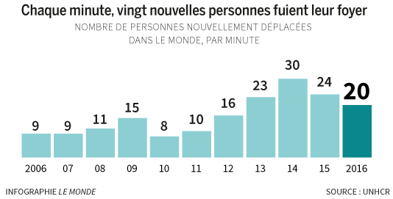
Magnitude of the phenomenon Every minute, twenty new people are displaced from their homes. The graph shows the number of new cases in the world per minute

Slide 14
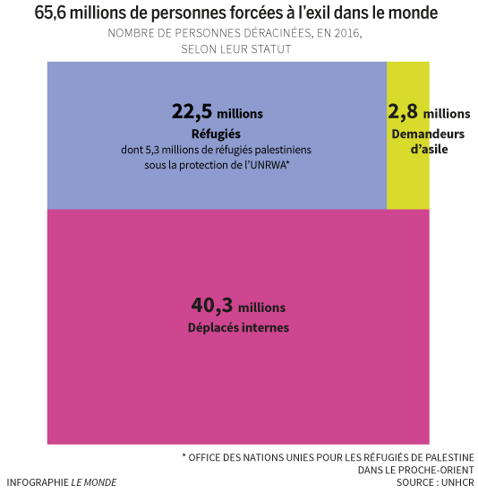
Status of people who left their home in 2016 65,6 million people were forced to exile in the world number of uprooted people in 2016 according to their status

Slide 15
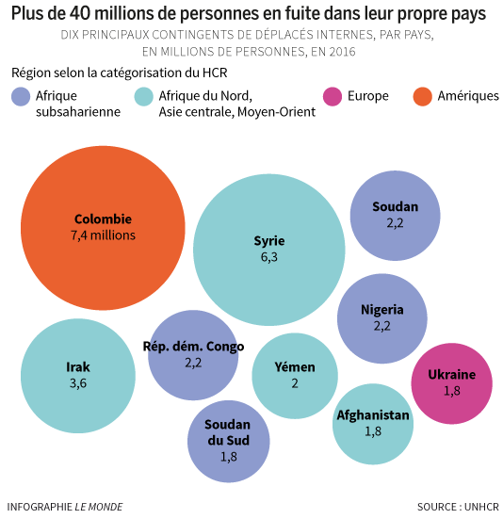
IDPs More than 40 million are displaced in their own countries 10 main contingent of internally displaced people per country in million. In 2016 Region according to the UNHCR: Sub Sahara Africa, North Africa, Central Asia, Middle East, Europe America

Slide 16
Refugees ( UN definition)
In addition to the internally displaced, more than 22.5 million refugees have fled abroad; 5.3 million of them are Palestinian refugees settled since 1948 in neighbouring countries and dependent on the United Nations Relief and Works Agency (UNRWA), while waiting for the question of their return to Israel to find an answer .

Slide 17
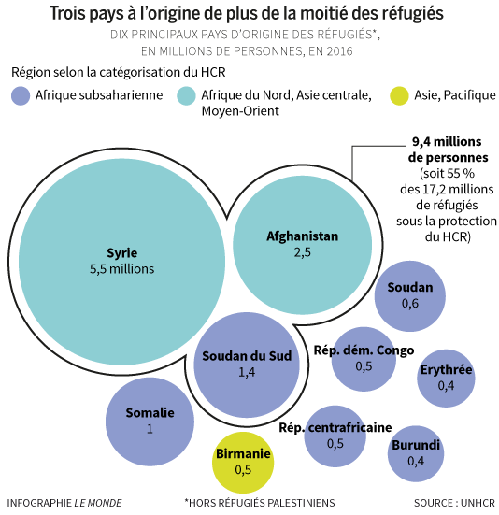
Syria, Afghanistan and Sudan: have half of refugees

Slide 18
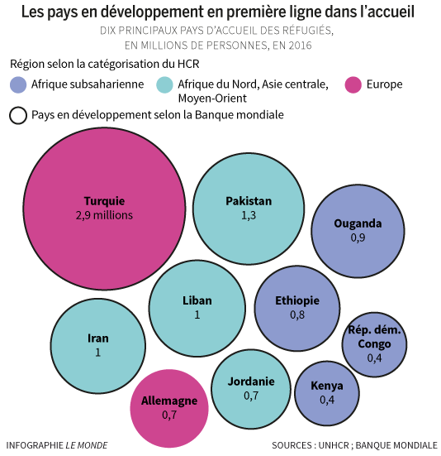
Reception of refugees

Slide 19
Reception of refugees
Fattori notes that, "contrary to popular belief, Western countries are far from absorbing most of the refugees. Indeed, the latter seek asylum in priority in neighbouring countries, with which their own country often shares, in addition to borders, a fragile economic and security situation.

Slide 20
.
Thus, it is clear that countries close to the main countries of origin of refugees are the main host countries, such as Turkey and Lebanon, the main destinations of Syrian exiles, Pakistan and Iran, which host, in some case for nearly three decades, fleeing Afghans. According to UNHCR, 84% of refugees are hosted by a developing country, for whom hosting refugees is a major challenge.

Slide 21
.
Among other figures recalled by UNHCR, the 2.8 million asylum seekers waiting for their file to be examined. Germany concentrated most of the requests in 2016, more than 700,000, far ahead of the United States (nearly 262,000), Italy (nearly 123,000) or France (78,000).

Slide 22
.
In 2016, some 7 million people (6.5 million IDPs and 500,000 exiles) were assisted by UNHCR in their return home or home countries, and 189,300 refugees relocated to a third country, including the United States (ie Canada, Australia, New Zealand, etc.?)

Slide 23
3.2. The causes of these displacements
Three sources:
1 ° Representative of the Secretary-General on internally displaced persons, (cited by Özden)
2 ° Melik Özden, Director of the Human Rights Program of the Europe-Third World Center (CETIM) and Permanent Representative to the United Nations; author of the booklet "Internally Displaced Persons: what is at stake on the Rights of Internally Displaced Persons and the Guiding Principles Adopted by the United Nations"
3 Inter-Parliamentary Union & UNHCR (2013): "Internally displaced people: responsibility and action". Guide for parliamentarians N ° 20-2013

Slide 24
6 causes according to the Representative of the Secretary-General on internally displaced people
In his comprehensive study presented at the 49th session of the Commission on Human Rights (CHR), the Representative of the Secretary-General identified six causes of displacement: (1) armed conflicts and internal disturbances, (2) forced relocations, 3 ° violence between communities, 4 ° natural disasters, 5 ° ecological disasters and 6 ° systematic violations of human rights.

Slide 25
Causes of displacements (continued)
Melik Özden adds 3 others:
population transfers (this is the settlement of settlers in the area where indigenous populations once lived);
forced evictions;
the ecological and social consequences of certain major development projects, such as the construction of dams or oil pipelines, or mining research and extractions that cause the displacement of large-scale populations (see illustrations)

Slide 26
According to the Inter-Parliamentary Union & the United Nations Refugee Agency (UNHCR)
armed conflict, according to the definition of international humanitarian law, these are situations where populations are victims or risk being attacked. This includes armed conflicts between States and armed conflicts between the state and non-state actors or between non-state actors;
a situation of widespread violence of an intensity or level that does not reach those of an armed conflict as defined by the Geneva Conventions of 1949 and their two Additional Protocols;
natural or anthropogenic disasters - rapid phenomena and, in some cases, slow-onset disasters, such as those caused by the effects of climate change

Slide 27
According to IPU & UNHCR (continued)
human rights violations deliberately targeting certain populations who may flee for their safety and shelter;
development or environmental protection activities - activities involving the establishment of infrastructure or other large-scale projects that may require the displacement of local residents (dam construction in India and Turkey, mining or oil extraction in Colombia and Sudan, etc.)

Slide 28
 | IPU & UNHCR | RSGNU to the displaced | Melik Özden = RSGNU + 3
1 | Armed conflict | Armed conflict | -
2 | Generalized violence | Forced relocation | -
3 | Natural or anthropogenic disasters | Violence between communities | -
4 | Violation of human rights | Natural disasters | -
5 | Development or environmental protection activities | Ecological disasters | -
6 |  | Systematic violation of human rights | -
(7) | - | - | Population transfer (resettlement of settlers in the area where hunted populations once lived)
(8) | - | - | Forced evictions
(9) | - | - | Ecological and social consequences of certain major development projects (dams, oil pipelines, research and mining or oil extraction, etc.)

Slide 29
Role of the Ombudsman / Ombudsman institutions: Prevention is better than cure
Require public authorities to improve good governance (political, administrative, security, social, economic)
Consider within our organizations (AOMA, AOMF, IOI, ...) the creation of a mechanism for conflict prevention and mediation

Slide 30
4. THE EXPERIENCE OF BURUNDI: The Institution of the Ombudsman for Conflict Prevention, and the Return of Refugees and Displaced People

Slide 31
.
.
SUMMARY PRESENTATION

Slide 32
4.1. CREATION OF THE INSTITUTION CONTEXT
After more than a decade of civil war following the assassination of the first democratically elected President (1993-2005).
A title dedicated to the Ombudsman by the Constitution of the Republic: title IX.
Establishment by Law N ° 1/03 of 25 January 2010, revised and became law N ° 1/04 of 24 January 2013 on the organization and functioning of the Ombudsman

Slide 33
.
4.2. ORGANIZATION AND OPERATION

Slide 35
4.2. Achievements and results
Ordinary mediation missions between the citizens and the Administration; Control of the functioning of administrations and public services;
2015 (during the crisis):
Meetings between leaders of political parties
Exchange meeting between the education unions, the organizing authorities, and the Teaching Administration;
Meetings between youth leagues affiliated with political parties;
Football tournament between young people of political parties

Slide 36
Achievements & results (continued 1)
2017: Special missions of rapprochement and reconciliation on general issues concerning relations with political and social forces (Article 6d of the law governing the Ombudsman)
Ombudsman meeting with political leaders in exile, Helsinki
Meeting with the Facilitator in the Burundian Dialogue, HE Benjamin W. MKAPA, Tanzania;
Reception of refugees returning to the country and planned visit of refugee camps

Slide 37
Achievements & results (continued 2)
Organization of a "political café" for political party leaders in KAYANZA;
Political Retreat of Political Party Leaders + Religious Leaders + Civil Society and Media Organizations, KAYANZA;
Dialogue-meeting of political leaders alone (at the Ombudsman's headquarters);
Return to the country of some political leaders refugees abroad;
Advocacy and obtaining a land for relocation of victims of landslide of a hill (NYARUHONGOKA) in RUMONGE province

Slide 38
4.3. Constraints, Challenges & Perspectives
constraints:
- very young institution: his 2nd term
- insufficient resources (financial, human, material);
Challenges and perspectives:
-Registration of institutional capacities
Provide the Institution with a Warning and Conflict Prevention Center

Slide 39
5. Executive Summary: The Ombudsman's Role in Protecting Human Rights
5.1. Ombudsman / Ombudsman is, in essence, an institution that listens to the people, mediates and protects human rights, regardless of their status: refugee, displaced or not.
5.2. The duties and powers of the Ombudsman depend on each national legislation, and hence on its legal and socio-political status.
5.3. By the mission of control of the functioning of the administration: a pillar of a State of right

Slide 40
General synthesis. (after)
5.4. Through listening, control, self-referral and special missions, the Ombudsman / Ombudsman is a warning and conflict prevention mechanism.
5. 5. Citizens trust and trust in the Institution of the Ombudsman / Ombudsman

Slide 41
6. Conclusion
In Summary, the Ombudsman is an auxiliary of the Government: he/she can help to fulfil its obligations under international human rights law, in particular by giving them advice on the implementation of the legislation. national practices and policies in line with international standards and principles in the field of human rights in general, refugees and IDPs in particular.
To fulfil its missions, the Ombudsman needs substantial resources

Slide 42
Sources & bibliographical references
-
A.O.M.A., 2014. Constitution of A.O.M.A, for adoption at the 4th session of the AOMA General Assembly in Addis Ababa, Ethiopia, 6 November 2014., Internet document, PDF.
- United Nations. General Assembly, Sixty-fifth session Item 69 (b) of the provisional agenda * The role of the ombudsman, the ombudsman and other national human rights institutions in the promotion and protection of human rights the man.
- Republic of Burundi: Constitution of the Republic, March 25, 2005.
- The Cimade. Migrations: State of play 2017. 75013 Paris, 64, rue Clisson
- Christophe Daum and Isaiah Dougnon. "Internal migration to the African continent" in Africa on the move. Another look, p. 6-11
Melik Özden (2017) "Internally Displaced Persons: State of Play on the Rights of Internally Displaced Persons and the Guiding Principles Adopted by the United Nations" Internet document, pdf,
U.I.P. & UNHCR (2013). Internally displaced persons:
responsibility and action. Guide for the use of parliamentarians, internet document, pdf

Slide 43
Discussion topics (in groups)
Do you think that our institutions have sufficient means to get involved in the problem of refugees and displaced people? if yes, which ones? If no, what's wrong? Ways forward ? How to get involved?
Are international mechanisms more effective than internal ones? If Yes, illustrate by concrete cases. If not, what prevents them? What is the way forward?

Slide 44
.
I thank you for your attention

